Slide 1

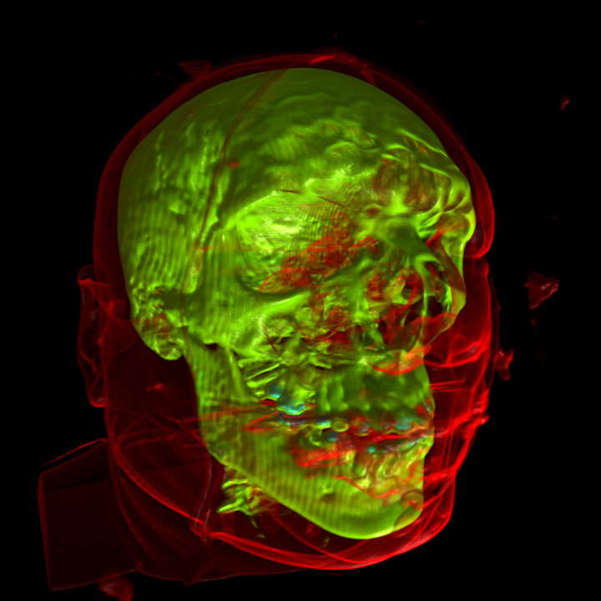


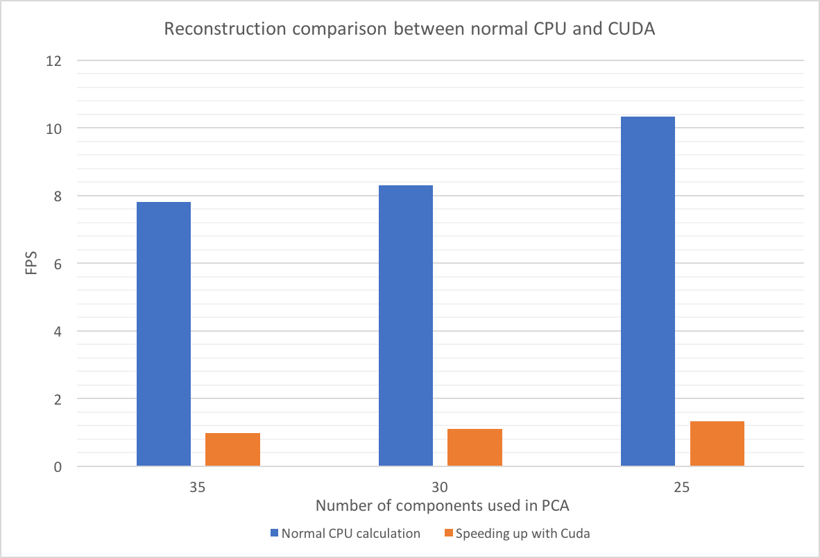
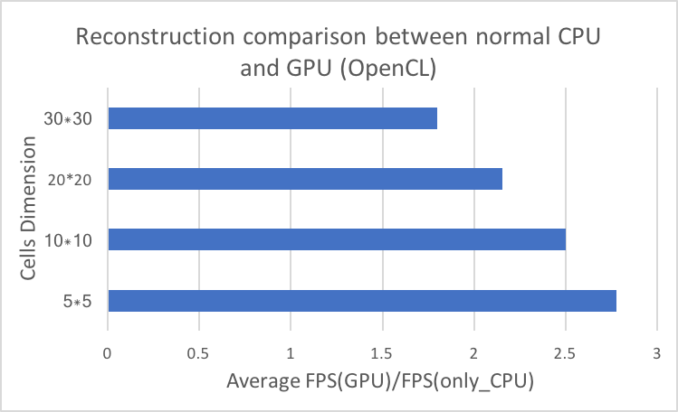
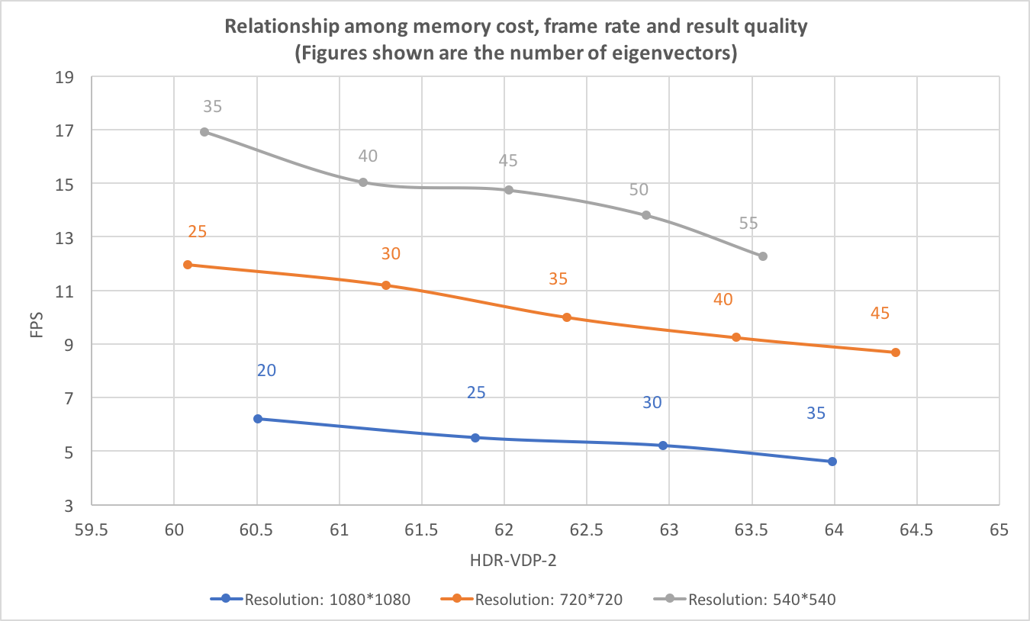
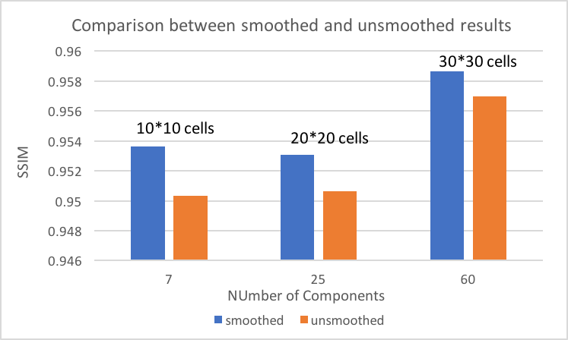
Image-Based Rendering for Volume Visualization by Using Principle Component Analysis
Yinghan Xu. Supervisor: John Dingliana
Introduction
Reconstruction Result
Volume rendering is an alternative approach to show objects. It gives the possibility to display more fuzzy surfaces and allows us to display 2D projection of a 3D discretely sampled data set. Volume rendering is typically popular and used for medical and engineering visulisations. However, with the rapid volume data expansion, the computation size becomes massive quickly. It’s more and more hard to get result images with high quality in real-time.
People proposed several image-based rendering techniques such as Lumigragh and Plenoptic function to replace volume rendering. Input data can be a set of images obtained from one of volume rendering techniques. For example, by linearly resampling original images, we an reconstruct new image with different angles.
The work in my project extends on work proposed in [1] for image-based volume rendering in PCA.
The left image is original input image with 720*720 resolution. The middle image is reconstructed result with the same resolution. The right image is zoomed in area of middle image (Cells dimension can be changed).
GPU Speed Up & Performance Evaluation
Implementation
Pre-processing (Only need to run once)
Obtain input training data, pre-rendered using a standard ray-caster, from a spherically distributed range of camera positions (In this project, I directly used the training data from [1]).
Calculate and save eigenspaces (PCA) based on training data (The dimension of observed objects can be changed according to cells size cropped from whole image).
Calculate and save back-projection scores for reconstructing process.
Reconstruction (The only step at run-time)
Result image is reconstructed by summation of product of some number of highest eigenvectors and corresponding scores projected on one original image.
Conclusions & Future Work
This dissertation implements a PCA image-based rendering in C++, mainly for volume rendered dataset. The reconstruction process is speeded up by two kinds of GPU kernel. One is CUDA and the other one is OpenCL function in OpenCV. Artefacts in result images were smoothed by MedianBlur function. Several performance experiments were tested for real-world applications.
In the future, some other multi-thread programming technique could be used to compare the performance. Multi-layers input training data can be used for showing different surfaces.
Reference
[1] Alakkari, S. and Dingliana, J., 2016, September. Volume visualization using principal component analysis. In Proceedings of the Eurographics Workshop on Visual Computing for Biology and Medicine (pp. 53-57). Eurographics Association.
Contact info: yixu@tcd.ie
M.Sc. in Computer Science
(Interactive Entertainment Technology)

